Slide 1


Slide 2

Any engineering students consider the compulsory physics courses in their degree as a form of refined torture.
The reasons for this a numerous; not least because university level physics is difficult and requires a way of thinking not usually taught in school.

Slide 3
PHYSICS - II
Electrodynamics:
Review of mathematical tools (Vector Algebra and Vector Calculus), Basic concepts of Electrostatics, gauss’s Law and its application, electric potential, work and energy in Electrostatics, conductors, Electrostatic Fields in Matters, Magnetostatic Fields in Matter, electromotive force, Faraday’s Law, Maxwell’s equations, Electromagnetic waves
Quantum Mechanics:
Failure of Classical concepts, Wave particle duality, Photoelectric effect, Black body radiation, Stefan’s law, Compton effect, concepts of wave packets: phase and group velocities, Heisenberg uncertainty principle and its applications, wave function and its physical interpretation, Probabilities, normalization, Expectation value, Eigen values, Eigen function, Time dependent and independent Schrödinger’s equation and its application in one dimension, Quantum statistics (Bose Einstein and Fermi Dirac)
Semiconductor Physics
Crystal Structure of semiconductor materials, Energy band of solids, Semiconductor in equilibrium, carrier transport phenomena, Physics of p-n junction in equilibrium and non equilibrium conditions
Suggested reading
A. Beiser - Concept of Modern Physics
D. Neamen – Semiconductor Physics and Devices
D. Griffiths - Introduction to Electrodynamics
Other helpful books:
3,000 Solved Problems in Physics (Schaum's Solved Problems)
The Feynman Lectures on Physics by Richard Phillips Feynman (Author)

Slide 4
Why study quantum physics?
Every year, quantum physics plays a larger role in engineering applications: semiconductors, nanotechnology, lasers, superconductors, MRI machines, CCD cameras, computers/mobile phones; this is a partial list of technologies which rely on quantum mechanics to work.
As an engineer you should have an understanding of how they work. If you don't, you'll be left behind.
One day we may succeed in building quantum computers. When that day comes, it will bring a technological revolution which hard to imagine. eg. Shor's algorithm factors numbers, which will make current RSA cryptography insecure. Quantum cryptography will allow private communication, ensuring that you and your communication partner are not eavesdropped on. When this revolution happens - you'll definitely need to understand the basics of quantum theory.

Slide 5
Why study quantum physics?
Why did you go to university in the rest place ? Was it just to get your engineering degree and get a job?
Or
Are you interested in expanding your horizons ? Quantum theory is one of the most interesting, bizarre, elegant and successful scientific theories ever made. Unlike most scientific theories, it is not the result of one person - it is the result of the combined effort of the best genius minds of the 20th century. This is your chance to learn it. Take this chance - life is busy - you may not get another.

Slide 6
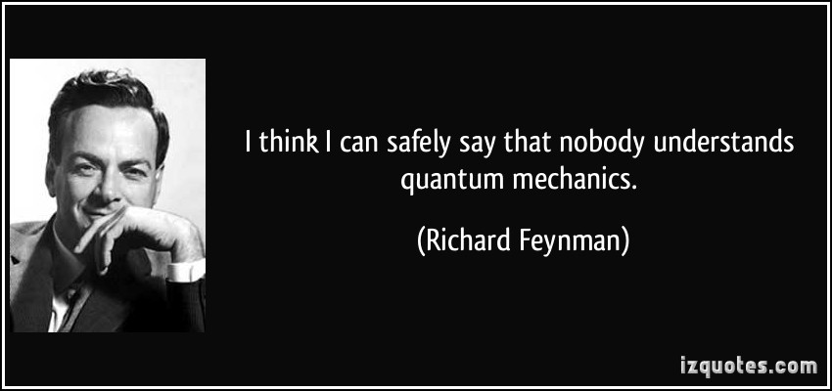
Quantum Mechanics
&
Semiconductor Physics
Dr. Manish Kumar Singh
Assistant Professor
Department of Physics

Slide 7
Method of Assessment
Assessments | Weightage(%)
Mid term exam | 40
Surprise quizzes, attendance and daily evaluation | 10
Final exam | 50

Slide 8

My lectures will be a mix of PPT slides and Black board!
Homework/Assignments
Some problem will be either beginning or end of the class in lecture classes.
You can work with others on homework (I encourage you to do so! Because you will be benefitted by discussion), but write it up yourself.
Quizzes
There will be one or two quizzes and will be used for your grades. The quiz dates are either announce earlier or may be surprise in any class.

Slide 9
The Importance of Having Class
You should come to class because there’s a lot that I’ll say that won’t be in the Power Point slides. And which will be on the quizzes/Exams.
In general people who have skipped a lot of classes have received very bad grades. Conversely, people who’ve come to most or all of the classes nearly always receive good grades.
“So please all of you attend every lecture”

Slide 10
Classical Mechanics
Classical Electrodynamics
Classical Thermodynamics
Classical Statistical Mechanics
Dark Clouds
“There is nothing new to be discovered in physics now.
All that remains is more and more precise measurement.”

Slide 11
On Friday, April 27, 1900,
the British physicist Lord Kelvin gave a speech entitled "Nineteenth-Century Clouds over the Dynamical Theory of Heat and Light," which began: The beauty and clearness of the dynamical theory, which asserts heat and light to be modes of motion, is at present obscured by two clouds.
What are the two Clouds?:
1. The inability to detect the luminous ether, specifically the failure of the Michelson-Morley experiment
2. The black body radiation effect known as the ultraviolet catastrophe
Notes:
http://physics.about.com/od/physicshistory/p/KelvinsDarkClouds.htm

Slide 12
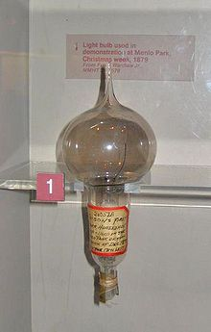
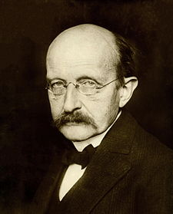
Where did the Quantum theory come from?
Thomas Allva Edison's first successful light bulb model, used in public demonstration at Menlo Park, December 1879
Max Planck (1858–1947), a German physicist considered to be the founder of quantum theory
Max Planck solved the black body radiation problem in 1900. (Presumably after Kelvin gave his speech.)

Slide 13
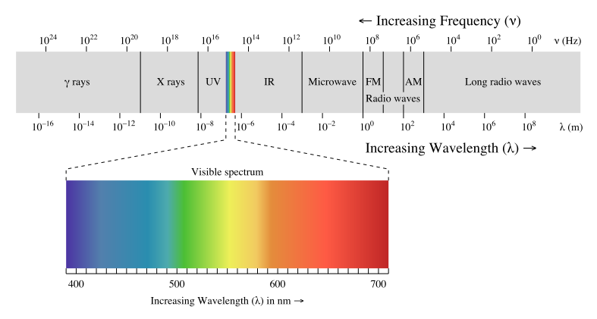
What is LIGHT?
Light consist of electromagnetic waves .
Visible Light is simply a name for a range of electromagnetic radiation that can be detected by the human eye.

Slide 14
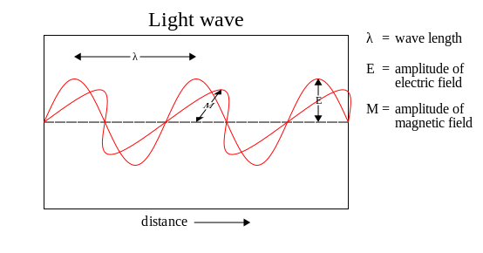
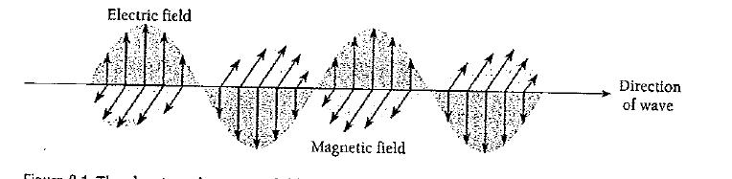
Light waves carry energy only in packets, with high frequency consisting of large packets of energy and low frequency light consisting of small packets of energy.
The idea that light comes in packets or “quanta”

Slide 15
Waves and Particles
Wavelength or
Frequency
Spread in space and time
Waves
Can be superposed – show
interference effects
Pass through each other
Localized in space and time
Particles
Cannot pass through each other -
they bounce or shatter.

Slide 16
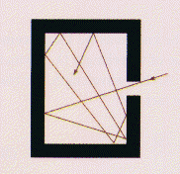
Definition of a black body
Black Body Radiation
A black body is an ideal body which allows the whole of the incident radiation to pass into itself ( without reflecting the energy ) and absorbs within itself this whole incident radiation (without passing on the energy). This propety is valid for radiation corresponding to all wavelengths and to all angels of incidence. Therefore, the black body is an ideal absorber of incident radiation.
Univ. of Oregon web site
Notes:
An oven with a small opening produces a very good blackbody spectrum.

Slide 17
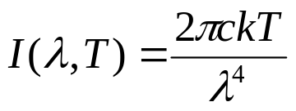
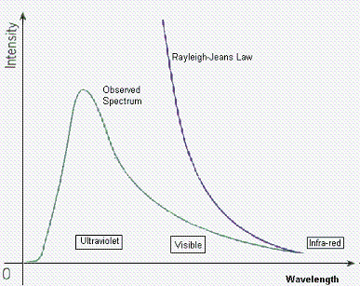
Black-Body Radiation Laws (1)
1- The Rayleigh-Jeans Law.
* It agrees with experimental measurements for long wavelengths.
* It predicts an energy output that diverges towards infinity as wavelengths grow smaller.
* The failure has become known as the ultraviolet catastrophe.
http://www.egglescliffe.org.uk/physics/astronomy/blackbody/Image22c.gif

Slide 18
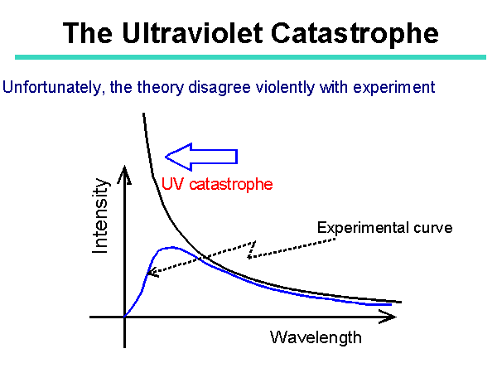


Ultraviolet Catastrophe
This formula also had a problem. The problem was the term in the denominator.
For large wavelengths it fitted the experimental data but it had major problems at shorter wavelengths.
http://theory.uwinnipeg.ca/users/gabor/foundations/quantum/images/slide5.gif

Slide 19
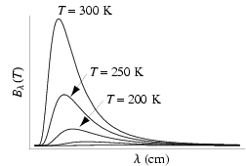
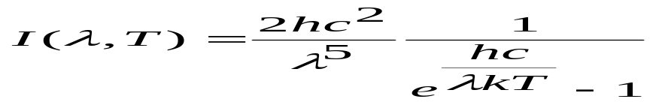
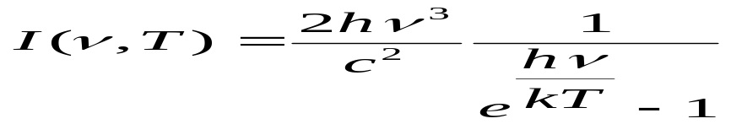
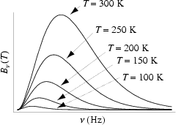
Black-Body Radiation Laws (2)
2- Planck Law
We have two forms. As a function of wavelength.
And as a function of frequency
The Planck Law gives a distribution that peaks at a certain wavelength, the peak shifts to shorter wavelengths for higher temperatures, and the area under the curve grows rapidly with increasing temperature.
http://scienceworld.wolfram.com/physics/PlanckLaw.html
Notes:
I:- Spectral radiance or energy per unit time per unit surface area per unit solid angle per unit frequency or wavelength. It has SI unit of J•s⁻¹•m⁻²•sr⁻¹•Hz⁻¹, or J•s⁻¹•m⁻²•sr⁻¹•m⁻¹.
C = nu * Lambda.

Slide 20
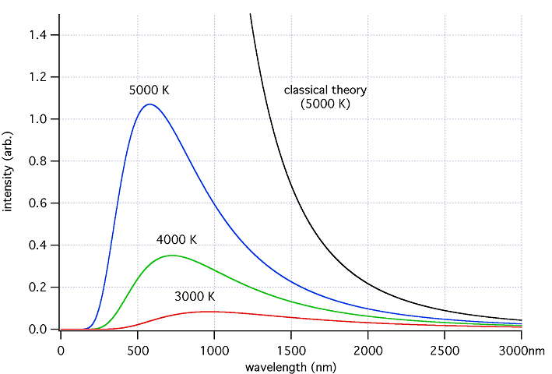
Comparison between Classical and Quantum viewpoint
There is a good fit at long wavelengths, but at short wavlengths there is a major disagreement. Rayleigh-Jeans ∞, but Black-body 0.
http://upload.wikimedia.org/wikipedia/commons/a/a1/Blackbody-lg.png

Slide 21
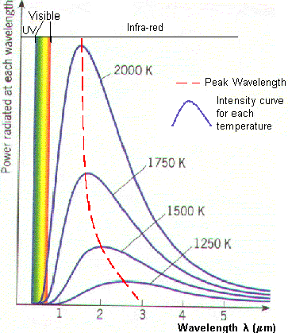
Conclusion
As the temperature increases, the peak wavelength emitted by the black body decreases.
As temperature increases, the total energy emitted increases, because the total area under the curve increases.
The curve gets infinitely close to the x-axis but never touches it.
http://www.astro.ufl.edu/~oliver/ast3722/lectures/BasicDetectors/BlackBody.gif

Slide 22
What is LIGHT?
Light consist of electromagnetic waves .
Visible Light is simply a name for a range of electromagnetic radiation that can be detected by the human eye.

Slide 23
Light waves carry energy only in packets, with high frequency consisting of large packets of energy and low frequency light consisting of small packets of energy.
The idea that light comes in packets or “quanta”

Slide 24
Waves and Particles
Wavelength or
Frequency
Spread in space and time
Waves
Can be superposed – show
interference effects
Pass through each other
Localized in space and time
Particles
Cannot pass through each other -
they bounce or shatter.

